Slide 1

Name of the project
Innovation Booster Living Labs for Decarbonisation
Application Kit

Slide 2
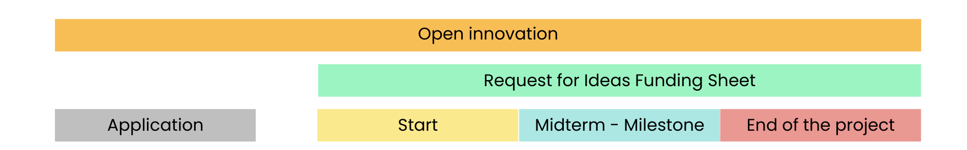
Documents requested through your Living Lab Consultant/Manager
Application kit:
Problem + Solution spaces
CV of the team
BMC
Video
Request for ideas Funding
Letter of co-funding
Programm rules aggreement
> More info in the application kit
Kick-off meeting
Grant Agreement
Terms of Services
Competencies
survey
First invoice (50%)
Beneficiary Declaration signed
Evidence of the co-funding transaction (bank transaction)
Second Invoice (50%)
Voucher (if needed)
Poster of the project
Methodology
integrative process of your project
Beneficiary survey
Competencies survey

Slide 3
Application Kit

Slide 4
Programme rules (to sign)
By posting your idea on this campaign you accept the general "Programme Rules" of our Innovation Booster Living Labs for Decarbonisation.
Make sure to take the time to read our “Programme Rules”. It helps you to understand better the process, the roles and specifics aspects of open innovation.
Please note that the title of your project and its description could be used for promotional communication.
Programme rules
Innovation beneficiary name
(member of the Team):
Date :
Signature (handwrittenl):

Slide 5

Title of the project
Location
Description :
Problem & Solution:

Slide 6
Video presentation
Please add your video via a link or directly on the Powerpoint

Slide 7
Problem space
General problematic
Customer segment problematic
Lorem lorem posum
Lorem lorem posum

Slide 8
Solution space
Description of your solution
Big challenges
Lorem lorem posum
Questions to take in account:
And how to overcome them

Slide 9
Competitive matrix
Please add the logos of your competitors
How do you differentiate yourself from the competitors?
Lorem lorem posum
Please add a topic
Please add a topic

Slide 10
SWOT Analysis
Fill this tool
Internal
Strengths
Weaknessses
Opportunities
Threats
External
Positive
Negative

Slide 11
Letter of co-funding
Name: xxx
Adress: xxx, 12xx xxxx
Add a link or an image…

Slide 12
CV of the Team (1/2)
Name & Surname
Name & Surname
Role in the project:
Skills:
Expériences:
Current position:
Short Description:
Role in the project:
Skills:
Expériences:
Current position:
Short Description:

Slide 13
CV of the Team (2/2)
Name & Surname
Name & Surname
Role in the project:
Skills:
Expériences:
Current position:
Short Description:
Role in the project:
Skills:
Expériences:
Current position:
Short Description:

Slide 14




Business Model Canva
You can choose between the usual BMC or the LIAISON one ​
Key Partners
Key Activities
Value Propositions
Customer Relationships
Customer Segments
…
…
…
…
…
Key Resources
Channels
…
…
Cost Structure
Revenue Streams
…
…
Original version: Strategyzer.com
This work is licensed under the Creative Commons Attribution-ShareAlike 4.0 International License.

Slide 15
Living Lab LIAISON Canva
You can choose between the usual BMC or the LIAISON one ​
PROBLEM
KEY ACTIVITIES
VALUE PROPOSITION
USER SEGMENTS
CUSTOMER SEGMENTS
SOLUTIONS
KEY STAKEHOLDERS
KEY RESOURCES
USER ENGAGEMENT
KEY METRICS
IMPACT
COST STRUCTURE
REVENUE STREAM
LivingLab Business Model Canvas by Juan A. Bertolin
is licensed under a Creative Commons Attribution-NonCommercial-ShareAlike 4.0 International License.
Based on a work at https://leanstack.com, https://strategyzer.com, https://socialleancanvas.com.

Slide 16
Excel - Budget
Please make sure to download the EXCEL file and upload it separately to your this document on HYPE.

Slide 17
Let's decarbonise Switzerland together...
Contacts
colm.kuonen@hevs.ch
laura.minisini@hevs.ch

