Slide 1
Innovation Booster Living Labs for Decarbonisation
Application Guide 2024

Slide 2
Content
The Innovation Booster Living Labs for Decarbonisation
Ideas application
Ideas evaluation
If you are successful

Slide 3
The Innovation Booster Living Labs for Decarbonisation

Slide 4
Innovation Boosters: take part to open innovation in Switzerland
Description :
Who is Innosuisse ?
Through the Innovation Boosters, Innosuisse brings together all interested parties from research, business and society around a series of innovation-related themes. These Innovation Boosters promote the transfer of knowledge and encourage cooperation with partners along the value chain surrounding a theme.
Participate and bring your innovation idea to life::
Be inspired by new perspectives
Meet new partners
Learn how to develop more radical ideas
Get funding and support to test or validate your ideas
Link to the Innosuisse page
Innosuisse is the Swiss innovation promotion agency. Its mission is to promote science-based innovation for the benefit of the economy and society.

Slide 5
Thematics of our Innovation Booster
Living Labs for Decarbonisation
Circular
Economy
Energy Efficiency
Digitalisation ​
Mobility

Slide 6
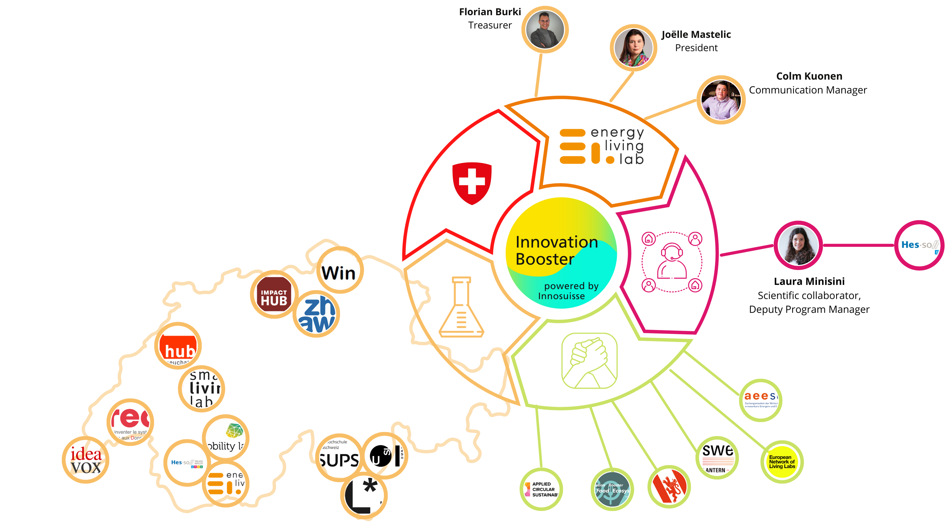
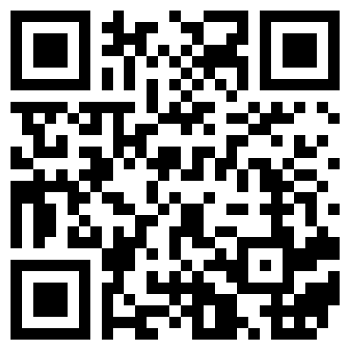
Our Network
Watch our video

Slide 7
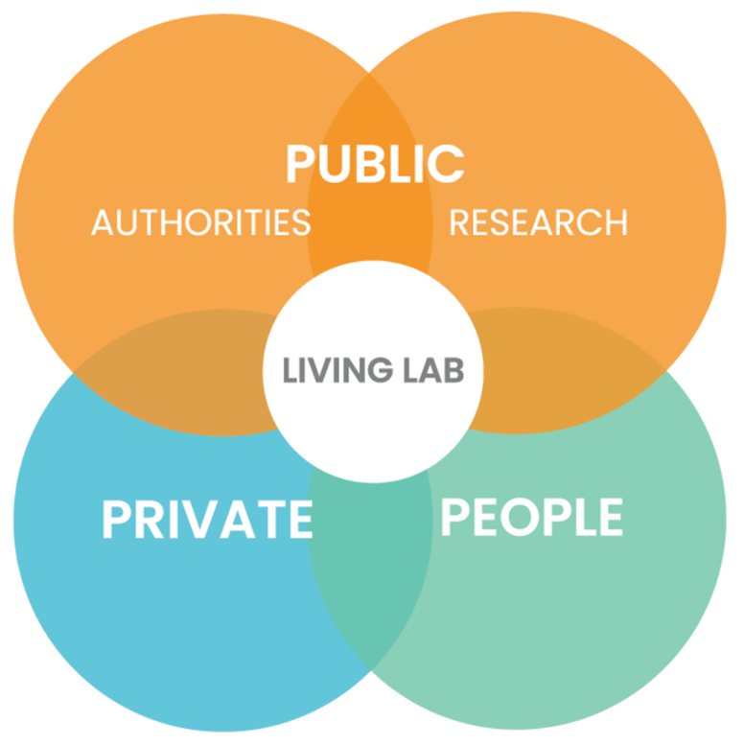
Quadruple Helix Model
LL orchestrates the collaboration of
four types of stakeholders:
Citizens
Research organizations
Private companies
Public authorities
This model is called the Quadruple Helix (Carayannis and Campbell, 2012).

Slide 8
^{Ideas funded}
2021
2022
2023
2024
Funded
Funded
Funded
Next sessions
13 Innovation Teams funded in 2021
5 digitalisation
4 energy efficiency
2 mobility
2 circular economy
13 Innovation Teams funded in 2022
3 circular economy
2 digitalisation
4 energy efficiency
4 mobility
14 Innovation Teams funded in 2023
5 circular economy
3 digitalisation
3 energy efficiency
2 mobility
14 ideas to be funded
Ideas evaluation deadlines
February 5
April 8
June 3

Slide 9
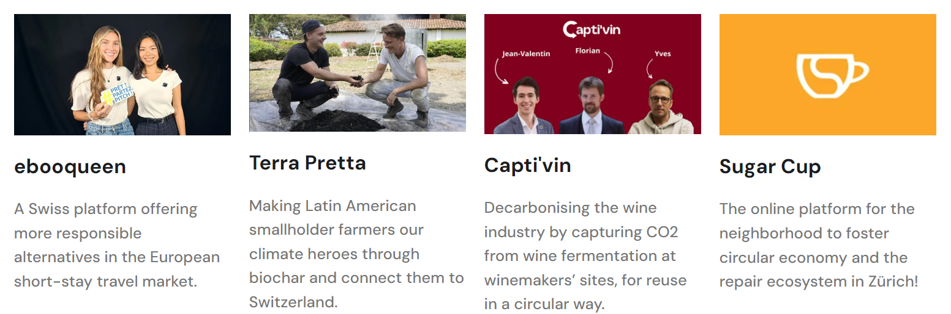
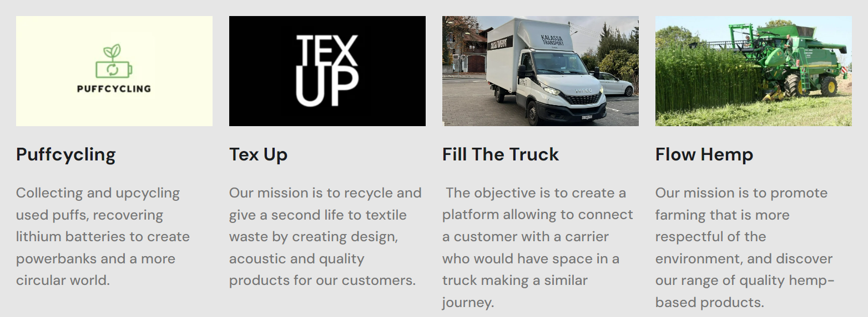
Innovation Teams funded in 2023
descriptions
Notes:
https://energylivinglab.com/innovation-teams-2023/

Slide 10
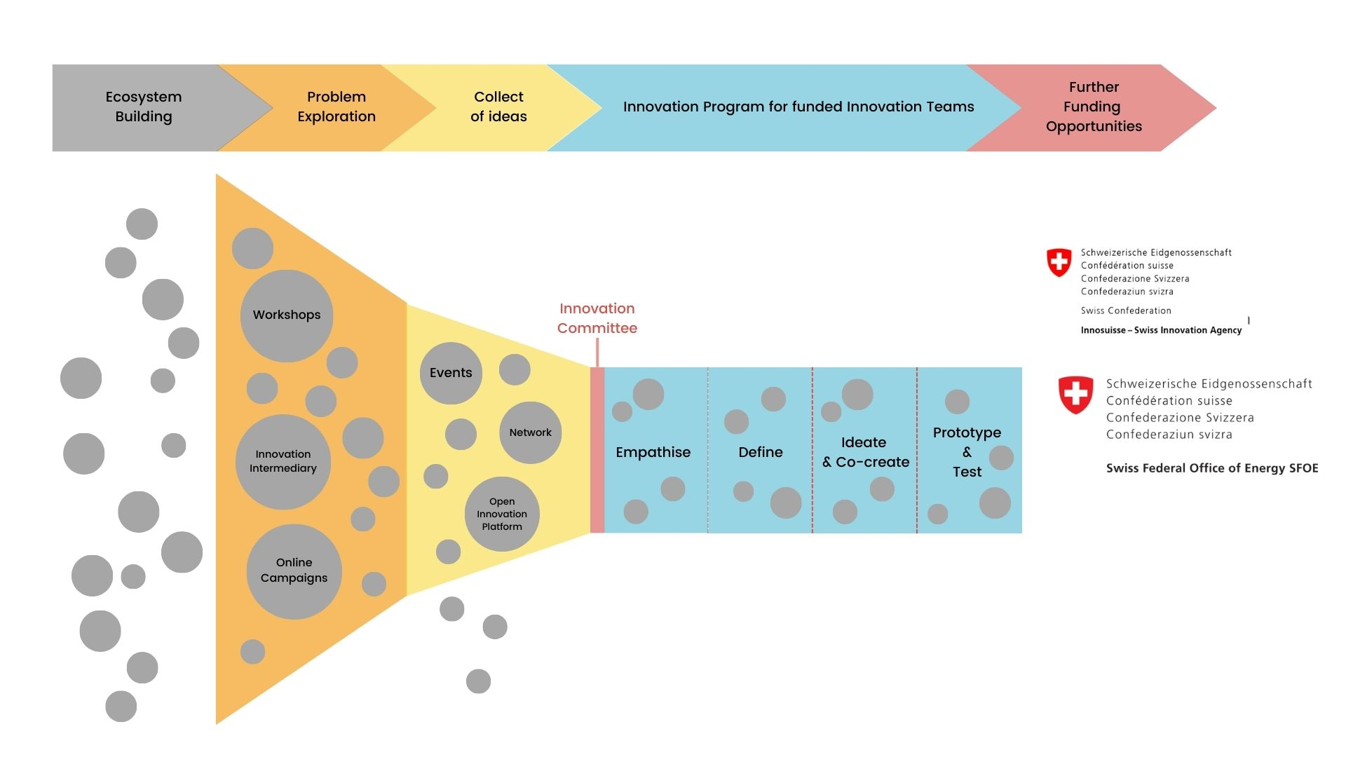
Our Innovation Process

Slide 11
^{How do we support the teams}
Coaching
Open innovation
methodologies
Ecosystem &
Network

Slide 12
Ideas application

Slide 13
^{How does is work?}
Win up to 20'000 CHF & Get local support
What do you need to do to apply?
Create an online account on our Innovation Platform
Post your ideas into our platform and we will contact you to fill out our Application kit.
Next Ideas Evaluations :
February 5– deadline
April 8– deadline
June 3 - deadline

Slide 14
What do you need to apply for the ideas funding?
Implementation partner to co-fund (15% startups, 20% SMEs & LC) - written co-funding declaration
Video presentation shared on YTB (privately)
1
4
A ‘request for ideas funding’ (xls) with a needs assessment completed by the Team and the Living Lab Consultant/Manager
2
A Business Model Canva (Or a BMC LIAISON)
5
3
A one page CV of all the Innovation team
6
All the documents can be found in the Application KIT on Teams

Slide 15
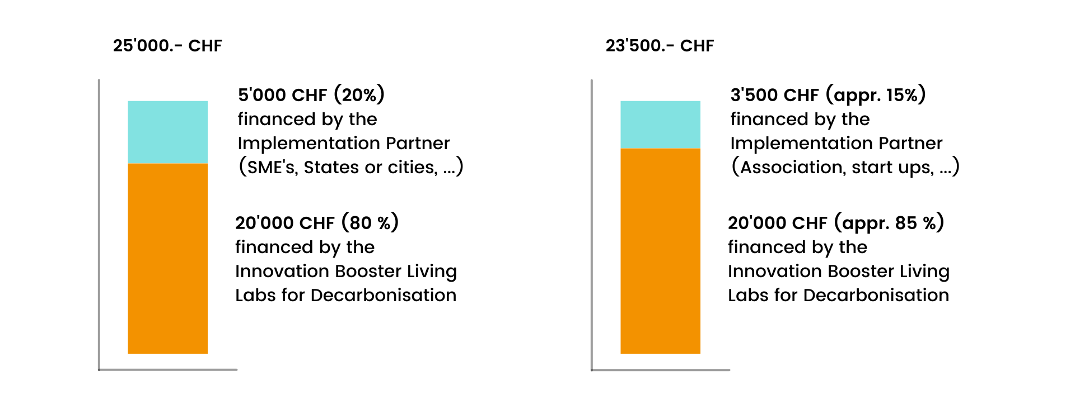
Implementation partner Financement & co-financement
Option A
Option B

Slide 16
Declaration of ideas funding
Please upload a letter or email from an authorized person of the Implementation Partner to confirm that the co-funding will be provided
minimum of 15% for Start Ups
and 20% from SMEs and Large Organizations
Evidence of the payment must be provided before the Ideas Funding is granted to the Living Lab/Innovation Team

Slide 17
^{Video presentation}
Maximum of 3 minutes / (language preference is English, however French, German and Italian are accepted – be aware that the Innovation Committee do not all speak the 3 swiss languages)
Post on Youtube channel (Not referenced link)
What should you describe in your video?
the problem,
the solution,
the social practice of the humans you would like to change,
a description of your innovation,
the impact in terms of decarbonization, social and economy,
who is on the team (Living Lab Manager, Implementation Partner and idea creators, …)

Slide 18
Needs assessment and
Request for Ideas Funding
Please use the document Request for Ideas Funding.xls to identify what your Innovation team propose to spend the ideas funding on:
Only the tab Request for Ideas funding is filled out at this step.
All the other tabs are to be completed only if you have a successful project and will be used throughout the process.
Please review the first tab, called Grant agreement to ensure that you will comply with the programme.

Slide 19
Open Innovation
Our programme is based on Open Innovation
Our community manifesto is available on HYPE
Please read and agree the Programme Rules on the website
A team agreement will be proposed for the Innovation teams when the ideas funding is granted.
Any confidentiality issues should be discussed between the Living Lab Consultant and the Innovation teams prior to submission of applications. The need for an NDA can be determined by the Living Lab Consultant/Innovation Team.
The Innovation teams will continue to work on the problem phase, mash up the idea, co-design, test and prototype with users, therefore the solution is expected to be the outcome of the innovation teamwork.
Experts will be made available as required.

Slide 20
Check list - Application Form on HYPE (via your living lab manager/ consultant)
agree to the programme rules
title *
Picture
Problem space
Solution space
you didn't submitted your idea to another Innovation Booster? *
if you took part to an open lab day, please mention which one: *
who is the implementation partner? *
co-funding declaration from the implementation partner *
video presentation of the project and the team (max. 5min) *
cv of the team *
Business Model Canva *
Needs assessment and Request for Ideas Funding *

Slide 21
Ideas evaluation

Slide 22
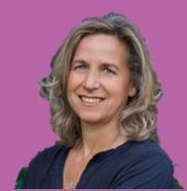
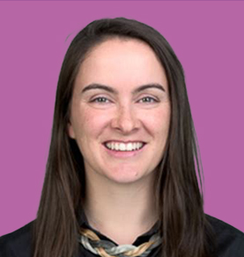
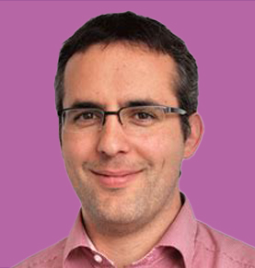
^{Innovation Committee}
ERIC BOLLIGER
LARA MOGGE
LAURA SCHWERY
BENEDICTE DERYCKERE
Meets 4x times a year to evaluate the ideas and decide which Innovation Team they fund
DEVON WEMYSS
PIERRE RODUIT
NATHALIE NYFFELER
ARNAUD BRULE
Notes:
Take our in 2023
Nomination for
* George Saad in Sion, business startup sector
* Jean-Valentin de Saussure <jv.desaussure@eqlosion.ch> (from Yves L.) from Swiss Youth for Climate

Slide 23
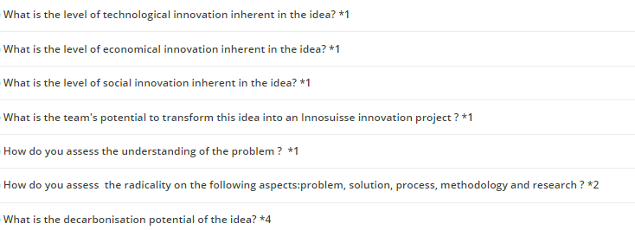
Criteria selection

Slide 24
If you are successful

Slide 25
Documents requested through your Living Lab Consultant/Manager
Application kit:
Problem + Solution spaces
CV of the team
BMC
Video
Request for ideas Funding
Letter of co-funding
Programm rules aggreement
> More info in the application kit
Kick-off meeting
Grant Agreement
Terms of Services
Competencies
survey
First invoice (50%)
Beneficiary Declaration signed
Evidence of the co-funding transaction (bank transaction)
Second Invoice (50%)
Voucher (if needed)
Poster of the project
Methodology
integrative process of your project
Beneficiary survey
Competencies survey

Slide 26
Grant Agreement
A signed grant agreement is required to start the project
A copy of the grant agreement is found in the first tab of the ‘Request for Ideas Funding’
A project Coordinator must be appointed.
Evidence of the co-funding transaction and expenses associated with the co-funding must be provided to the ELLA
The Living Lab Consultant/ Manager has the role of 'external methodological support’.
A separate contract for any services offered by the Living Lab Consultant is recommended as per the programme rules.
A payment of 50% is made upfront and a second payment of 50% of the ideas funding is provided when the milestones are reached.

Slide 27
Thank you !
Energy Living Lab Association
Email : info@energylivinglab.com
Ideation platform: innobooster.org

